Slide 1
How to Do HW 4:
Automated Parking
ME 452 – Vehicle Dynamics, Fall 2026

Slide 2
This assignment will show how to plan an automated parking maneuver
The student assignment is to modify the codes so that they work with the student’s vehicle and to allow backing-in maneuvers.
Hints are given in the code and the slides on how to do this!

Slide 3
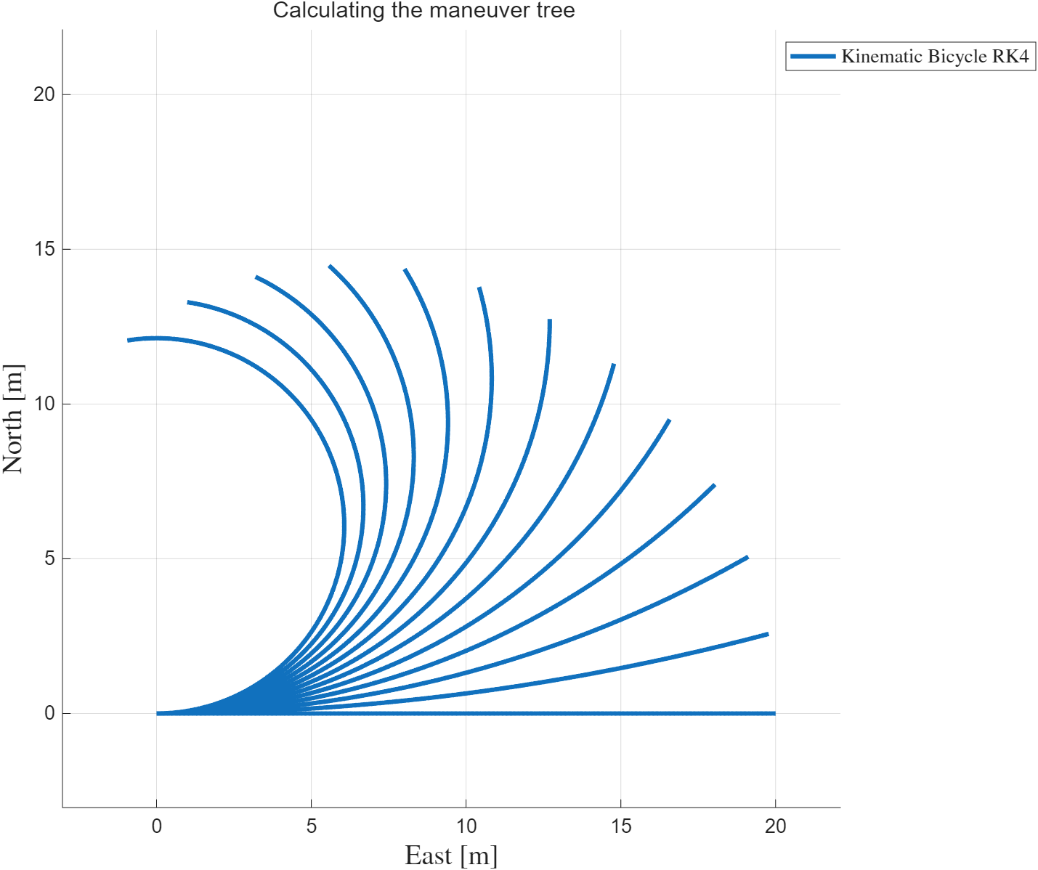
To automate parking, we need to define what parking means as inputs and outputs
For a given set of steering inputs, we can use the maneuver tree to calculate the trajectories
(see fcn_VD_forwardReachabilityTreeRK4)
figNum = 10001;
figure(figNum); clf;
% Set the simulation time/state arguments
initialStates = [0 0 0]; % [X Y phi] in [m],[m],[rad]
deltaT = 0.01; % Units are [sec]
startTime = 0;
endTime = 10;
timeInterval = [startTime endTime]; % Units are [sec]
steeringInterval = ((0:2:25)')*pi/180; % Units are [rad]
% Set up vehicle parameters
clear vehicleParameters
vehicleParameters.U = 2; % U is forward velocity of vehicle in longitudinal direction, [m/s] (rule of thumb: 5 mph ~= 2* m/s)
vehicleParameters.L = 2.700; % wheelbase in meters of a 2013 Prius, standard class
modelIDToUse = 1; % Kinematic bicycle model
% Call the function
[stateTrajectories, times, steeringAnglesUsed] = ...
fcn_VD_forwardReachabilityTreeRK4(...
initialStates, ...
deltaT, timeInterval, steeringInterval, vehicleParameters, ...
modelIDToUse, (figNum));
sgtitle('Calculating the maneuver tree', 'Interpreter','none');

Slide 4
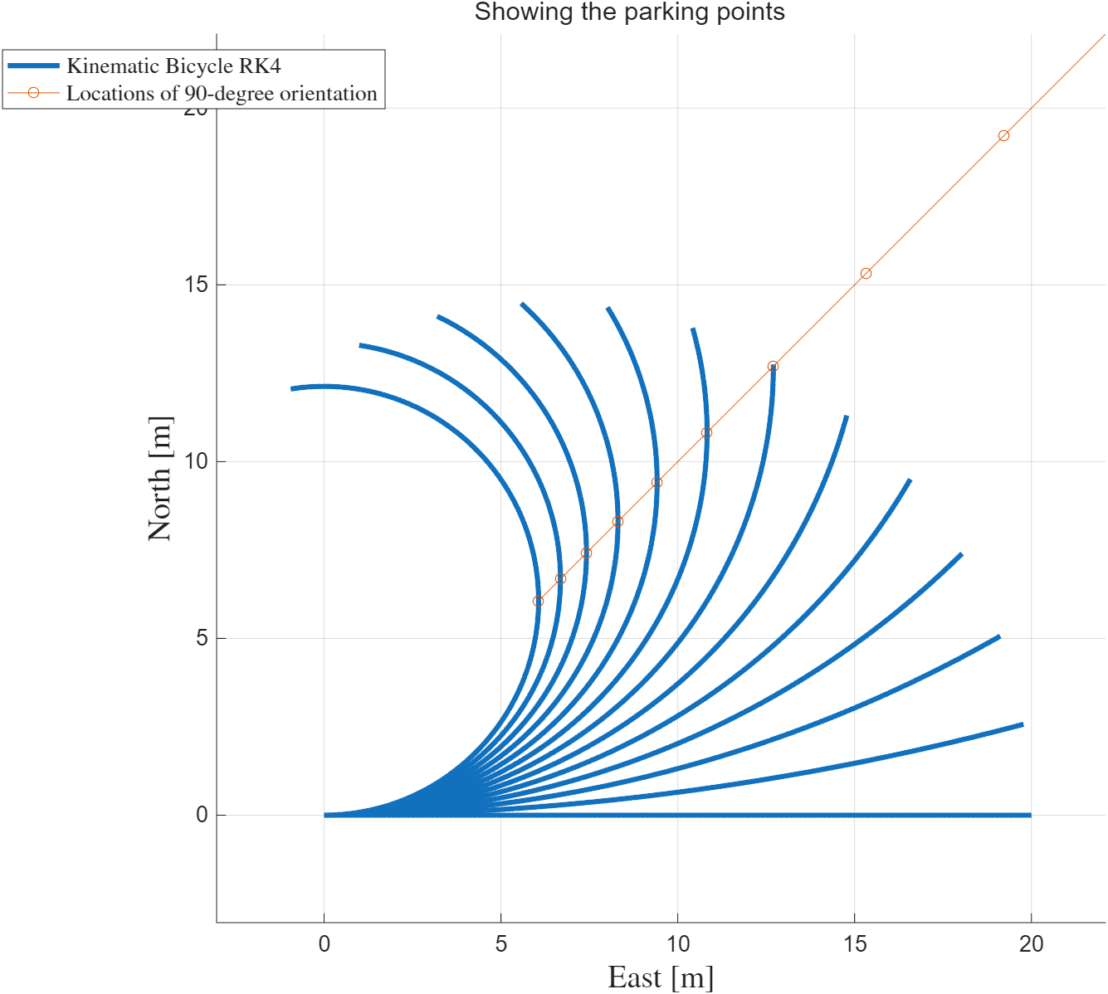
Assuming we are parking at 90 degrees, we can find the points where each trajectory “parks”
%% Plot the locations of 90-degrees
all90DegreeXYPoints = nan(length(steeringInterval),2);
for ith_steering = 1:length(steeringInterval)
thisSteering = steeringInterval(ith_steering); % This is in radians
thisRadius = vehicleParameters.L/tan(thisSteering); % In meters
all90DegreeXYPoints(ith_steering,:) = [thisRadius thisRadius];
end
plot(all90DegreeXYPoints(:,1),all90DegreeXYPoints(:,2),'-o','DisplayName','Locations of 90-degree orientation');
sgtitle('Showing the parking points', 'Interpreter','none');
We can see this is a line. This shows that tighter turning angles gives smaller areas where we can park. But it also shows there’s not much difference between 24 degrees and 20 degrees. Which do we choose?

Slide 5
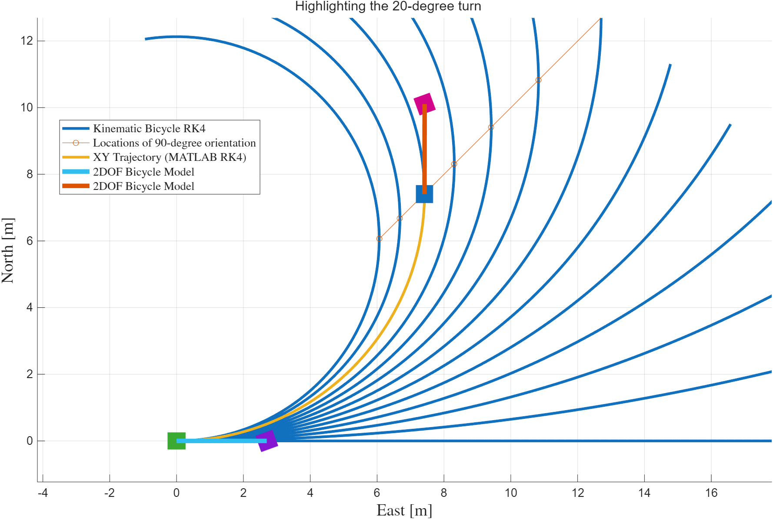
It depends! We know we want tight spacing, so we want to choose LARGE steering
BUT, if we choose the largest, we cannot correct the trajectory any “tighter” if we are too large… at least, not without backing up. So here, we’ll choose 20 degrees to balance these two issues. We can redo the calculations later if we want to do larger steering angles.
%% Plot the 20-degree solution
% Uses fcn_VD_kinematicBicycleModelRK4
% Set up inputs
steering_amplitude_degrees = 20; % 2 degrees of steering amplitude for input sinewave
steering_amplitude_radians = steering_amplitude_degrees*pi/180;
predictedTurnRadius = vehicleParameters.L/tan(steering_amplitude_radians);
% Set the simulation time/state arguments
initialStates = [0 0 0]; % [X Y phi] in [m],[m],[rad]
deltaT = 0.01; % Units are [sec]
startTime = 0;
arcLength = 90*pi/180*predictedTurnRadius;
endTime = arcLength/vehicleParameters.U;
timeInterval = [startTime endTime]; % Units are [sec]
simulationTimes = (startTime:deltaT:endTime)';
inputsVsTime = [simulationTimes steering_amplitude_radians*ones(length(simulationTimes(:,1)),1)]; % [times steering angles]
% Call the function
[stateTrajectory, ~, steeringUsed] = ...
fcn_VD_kinematicBicycleModelRK4(initialStates, deltaT, ...
timeInterval, inputsVsTime, vehicleParameters, (figNum));
fcn_VD_plotStickFigure2DOFBicycleModel(vehicleParameters, stateTrajectory(1,:)', [steeringUsed(1,1); 0], true, (figNum));
fcn_VD_plotStickFigure2DOFBicycleModel(vehicleParameters, stateTrajectory(end,:)', [steeringUsed(end,1); 0], true, (figNum));
sgtitle('Highlighting the 20-degree turn', 'Interpreter','none');

Slide 6
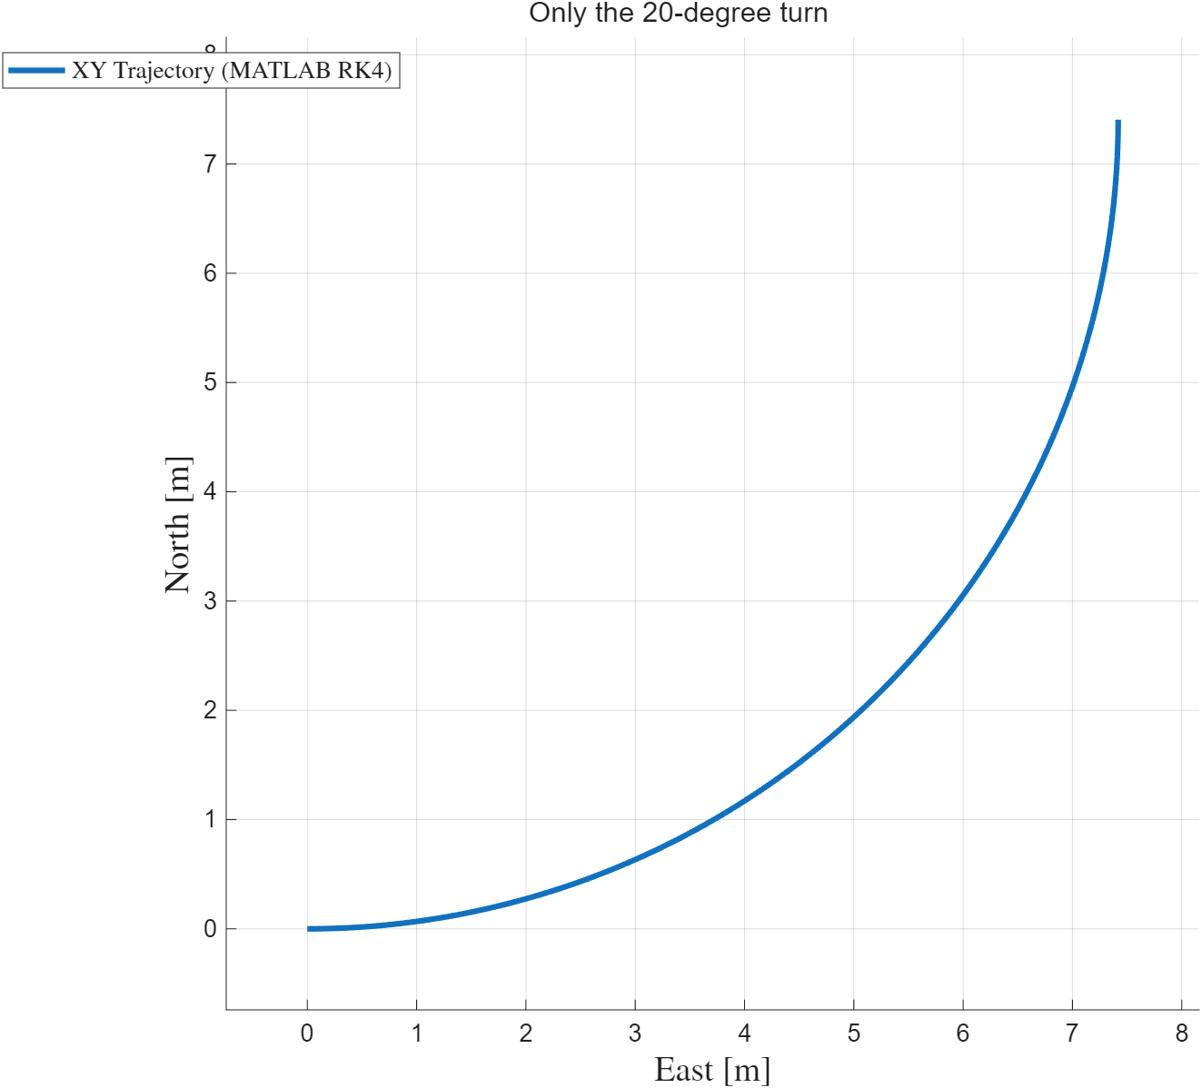
We can observe that ALL positions on this arc are possible parking places produced by this SAME steering input
%% Plot ONLY the 20-degree solution
figNum = 10002;
% Set up inputs
steering_amplitude_degrees = 20; % 2 degrees of steering amplitude for input sinewave
steering_amplitude_radians = steering_amplitude_degrees*pi/180;
predictedTurnRadius = vehicleParameters.L/tan(steering_amplitude_radians);
% Set the simulation time/state arguments
initialStates = [0 0 0]; % [X Y phi] in [m],[m],[rad]
deltaT = 0.01; % Units are [sec]
startTime = 0;
arcLength = 90*pi/180*predictedTurnRadius;
endTime = arcLength/vehicleParameters.U;
timeInterval = [startTime endTime]; % Units are [sec]
simulationTimes = (startTime:deltaT:endTime)';
inputsVsTime = [simulationTimes steering_amplitude_radians*ones(length(simulationTimes(:,1)),1)]; % [times steering angles]
% Call the function
[stateTrajectory, ~, steeringUsed] = ...
fcn_VD_kinematicBicycleModelRK4(initialStates, deltaT, ...
timeInterval, inputsVsTime, vehicleParameters, (figNum));
sgtitle('Only the 20-degree turn', 'Interpreter','none');

Slide 7
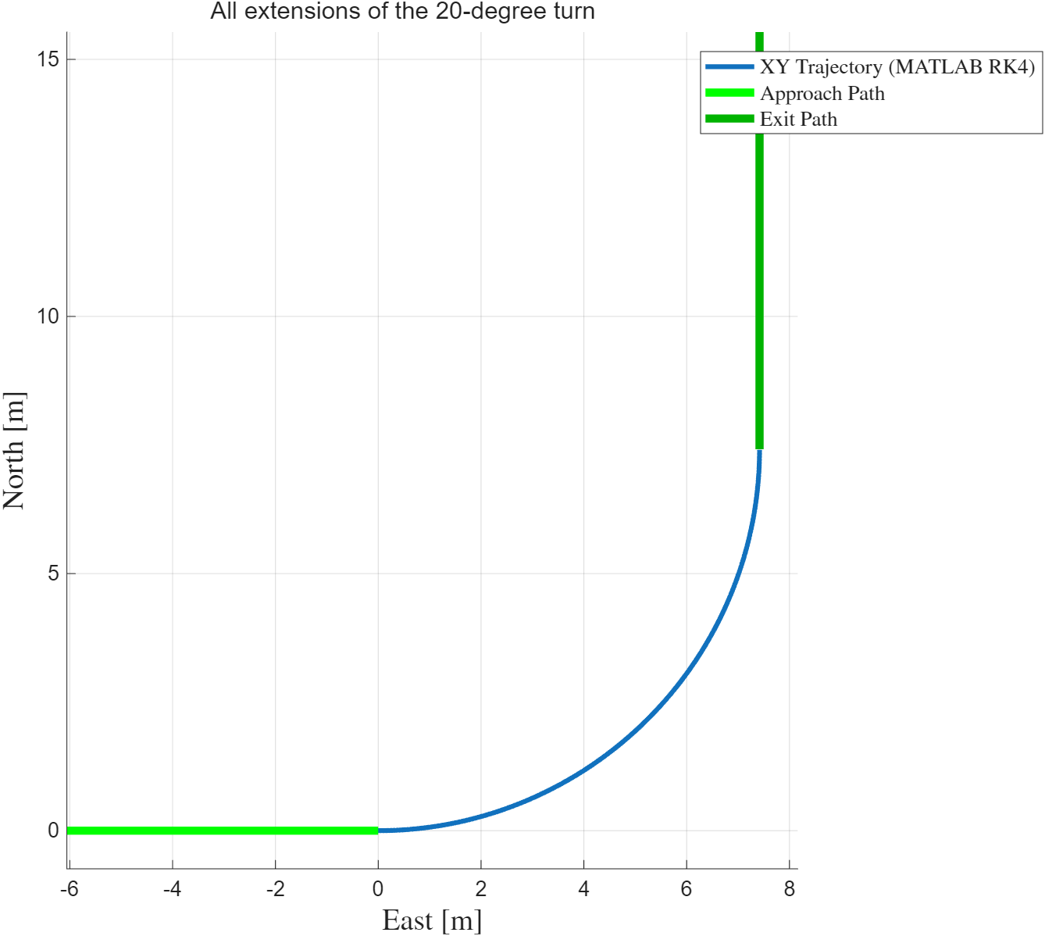
As well, if we allow straight lines on entry and exit, all points on this path share the same maneuver, as long as we start each maneuver at [0, 0]
%% Plot approach and exit
approachPath = [-10 0; 0 0];
exitPath = [predictedTurnRadius predictedTurnRadius; predictedTurnRadius predictedTurnRadius+10];
plot(approachPath(:,1),approachPath(:,2),'-','Color',[0 1 0],'LineWidth',5,'DisplayName','Approach Path')
plot(exitPath(:,1),exitPath(:,2),'-','Color',0.7*[0 1 0],'LineWidth',5,'DisplayName','Exit Path')
fcn_VD_plotStickFigure2DOFBicycleModel(vehicleParameters, stateTrajectory(1,:)', [steeringUsed(1,1); 0], true, (figNum));
fcn_VD_plotStickFigure2DOFBicycleModel(vehicleParameters, stateTrajectory(end,:)', [steeringUsed(end,1); 0], true, (figNum));
sgtitle('All extensions of the 20-degree turn', 'Interpreter','none');

Slide 8
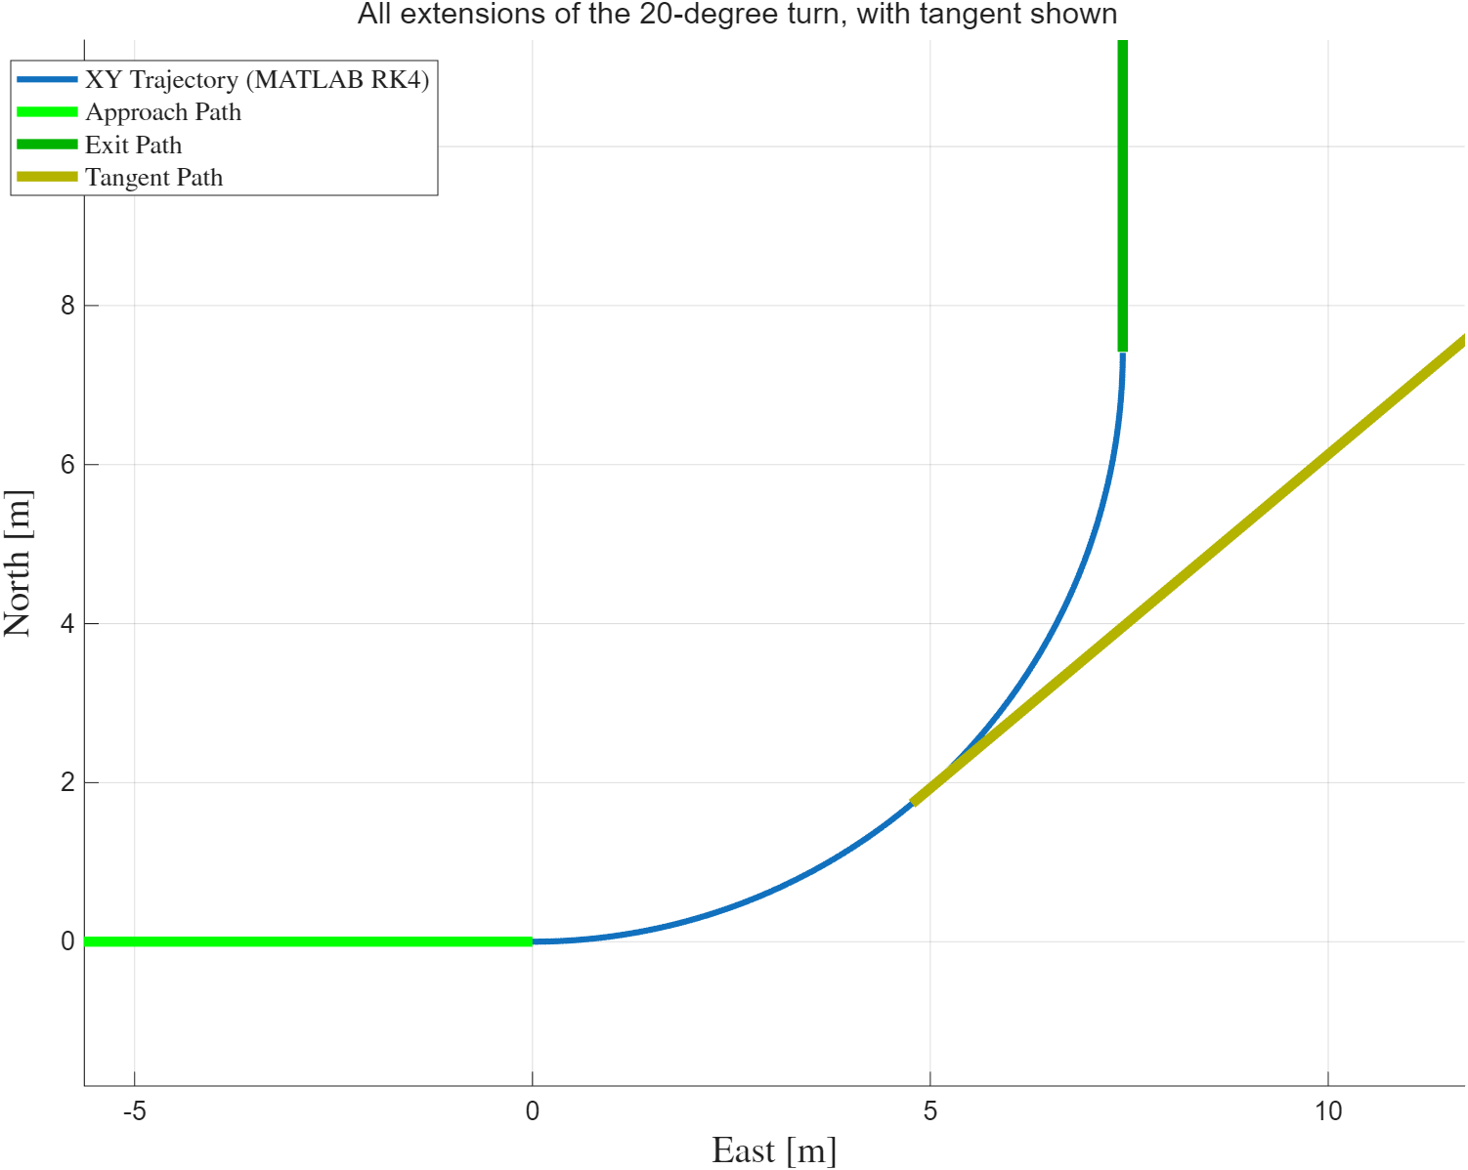
Finally, we notice that all tangent trajectories share the same path, as long as we track where the tangents start
%% Plot tangent
tangentIndex = find(stateTrajectory(:,3)>(40*pi/180),1); % Find first location greater than 40 degrees
tangentStates = stateTrajectory(tangentIndex,:);
angleRad = tangentStates(1,3);
rotation = [cos(angleRad) sin(angleRad); -sin(angleRad) cos(angleRad)];
tangentPath = [0 0; 20 0]*rotation + [tangentStates(1,1)*ones(2,1) tangentStates(1,2)*ones(2,1)] ;
plot(tangentPath(:,1),tangentPath(:,2),'-','Color',0.7*[1 1 0],'LineWidth',5,'DisplayName','Tangent Path')
sgtitle('All extensions of the 20-degree turn, with tangent shown', 'Interpreter','none');

Slide 9
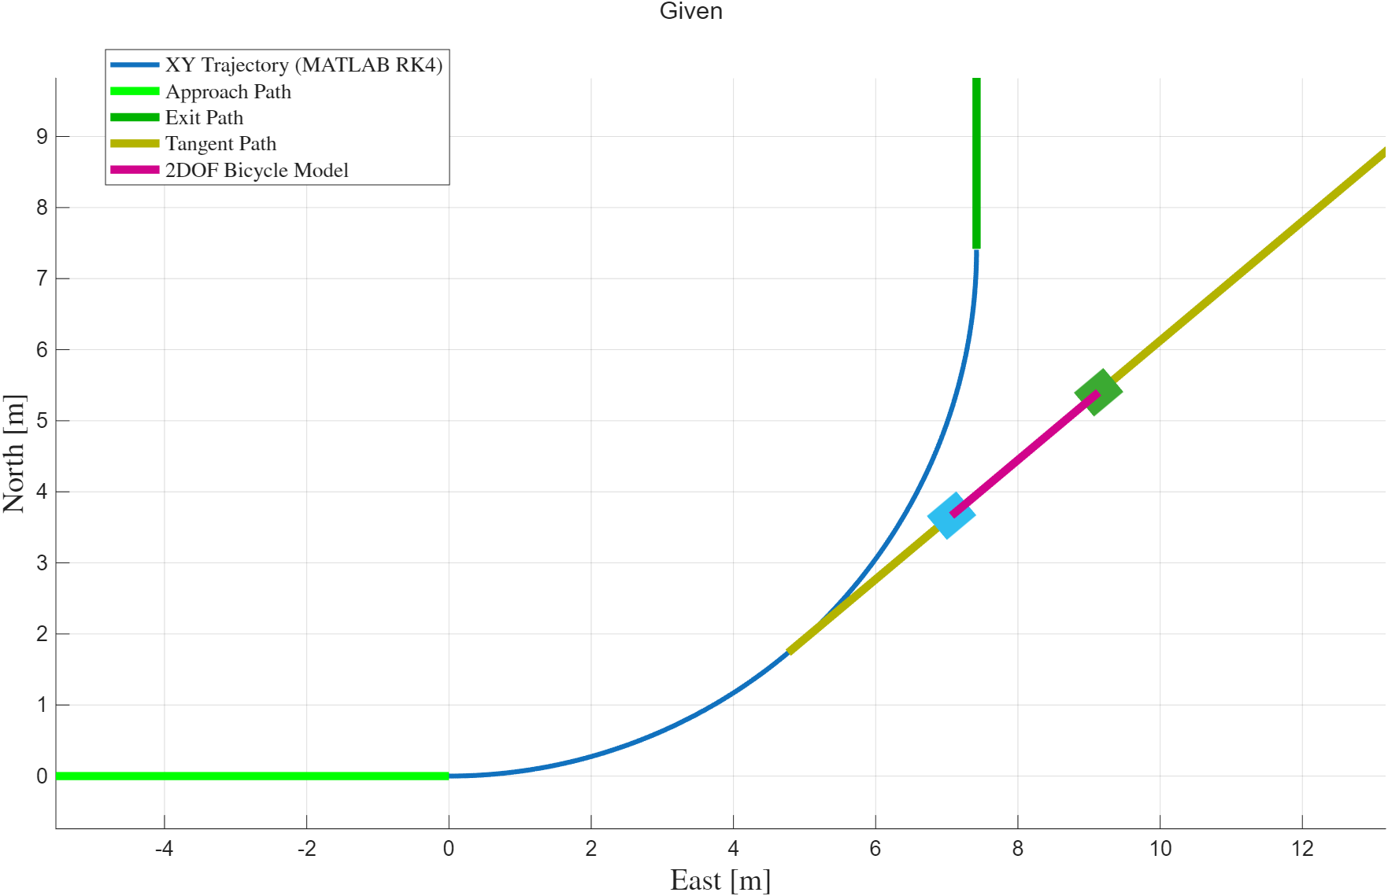
So let’s come back to our parking goal, what are we given?
We should assume that the user gives us the location of the center of the rear axle, the orientation we want to be at, and the radius to turn (this is fixed in our algorithm).

Slide 10
What do we want to find?
We need to know:
The start point of our maneuver (the x-location of the start of the maneuver),
How far along the arc to proceed (the y-location of the arc’s end)
How far after the arc’s end to continue straight.

Slide 11
How do we turn this information into a method to park the car? And by “park”, we mean to generate an approach path, the path of the arc, and the exit path.
There are many strategies we can use. The approach below is similar to a method called the Dubbin’s curve approach, which creates trajectories by connecting arcs. The modifications here, however, allow non-uniform arcs (more on this later).
Steps:
Convert everything to the current vehicle local xy frame
Find the x-axis intercept of the given pose
Make sure this is in the feasible range.
Calculate the “approach” distance, the “exit” distance, and the arc angle.

Slide 12
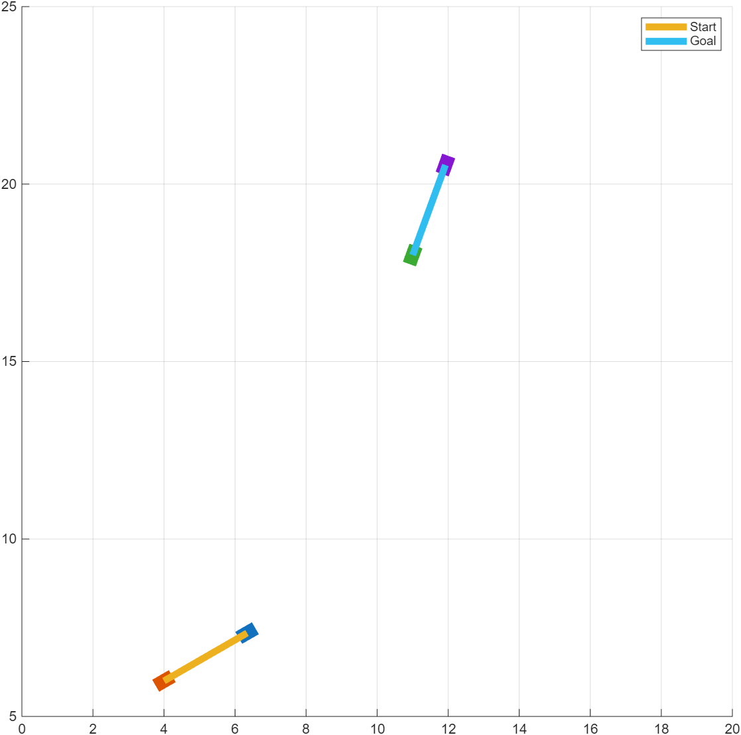
To illustrate the problem, we’ll start with a toy example
%% Example case
figNum = 10003;
figure(figNum);clf;
goalPointInXYphi = [11 18 70*pi/180];
startingPointInXYphi = [4 6 30*pi/180];
% Plot scenario
h_start = fcn_VD_plotStickFigure2DOFBicycleModel(vehicleParameters, startingPointInXYphi', [0; 0], true, (figNum));
set(h_start{1},'DisplayName','Start');
h_end = fcn_VD_plotStickFigure2DOFBicycleModel(vehicleParameters, goalPointInXYphi', [0; 0], true, (figNum));
set(h_end{1},'DisplayName','Goal');
legend('Interpreter','none');
axis([0 20 5 25]);

Slide 13
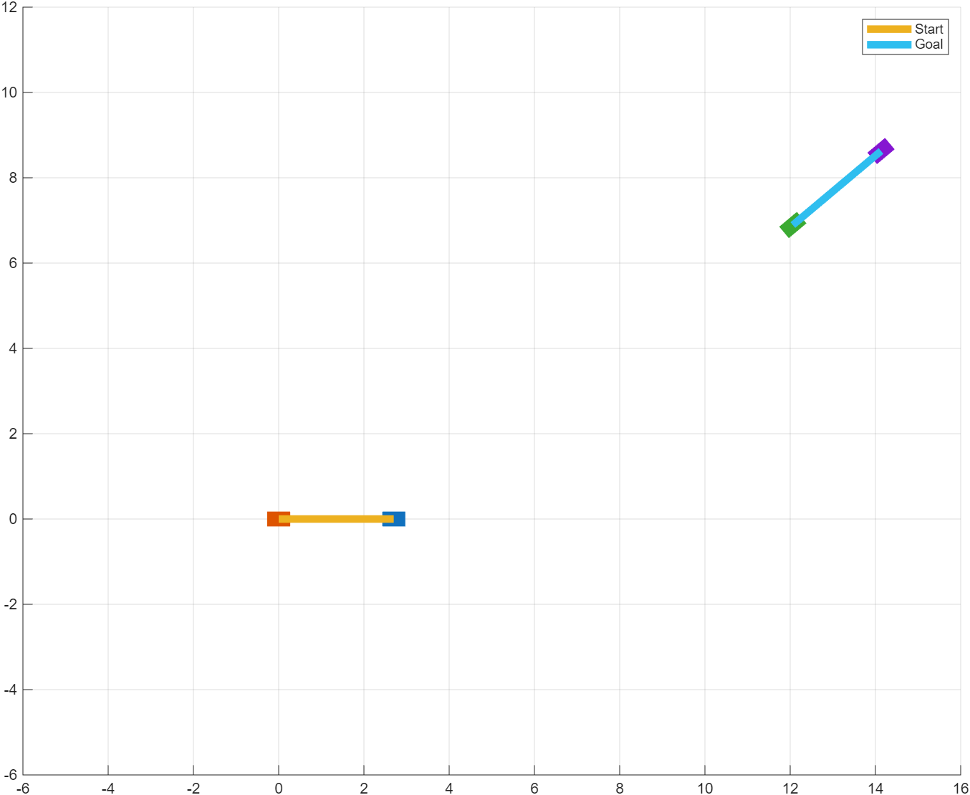
Step 1: Convert the problem into the vehicle’s local xy coordinates
This step subtracts the initial offset position and rotates all the points by the negative of the initial angle
%% Step 1
figNum = 10004;
figure(figNum);clf;
angleRad = -1*startingPointInXYphi(1,3);
rotation = [cos(angleRad) sin(angleRad); -sin(angleRad) cos(angleRad)];
pointsToMoveXYphi = [startingPointInXYphi; goalPointInXYphi];
pointsToMoveXY = pointsToMoveXYphi(:,1:2);
movedInXY = pointsToMoveXY - ones(2,1)*startingPointInXYphi(1,1:2);
movedRotatedInXY = movedInXY*rotation;
movedStartingPointInXYphi = [movedRotatedInXY(1,:) startingPointInXYphi(1,3)+angleRad];
movedGoalPointInXYphi = [movedRotatedInXY(2,:) goalPointInXYphi(1,3)+angleRad];
% Plot scenario
h_start = fcn_VD_plotStickFigure2DOFBicycleModel(vehicleParameters, movedStartingPointInXYphi', [0; 0], true, (figNum));
set(h_start{1},'DisplayName','Start');
h_end = fcn_VD_plotStickFigure2DOFBicycleModel(vehicleParameters, movedGoalPointInXYphi', [0; 0], true, (figNum));
set(h_end{1},'DisplayName','Goal');
legend('Interpreter','none');
axis([-6 16 -6 12]);

Slide 14
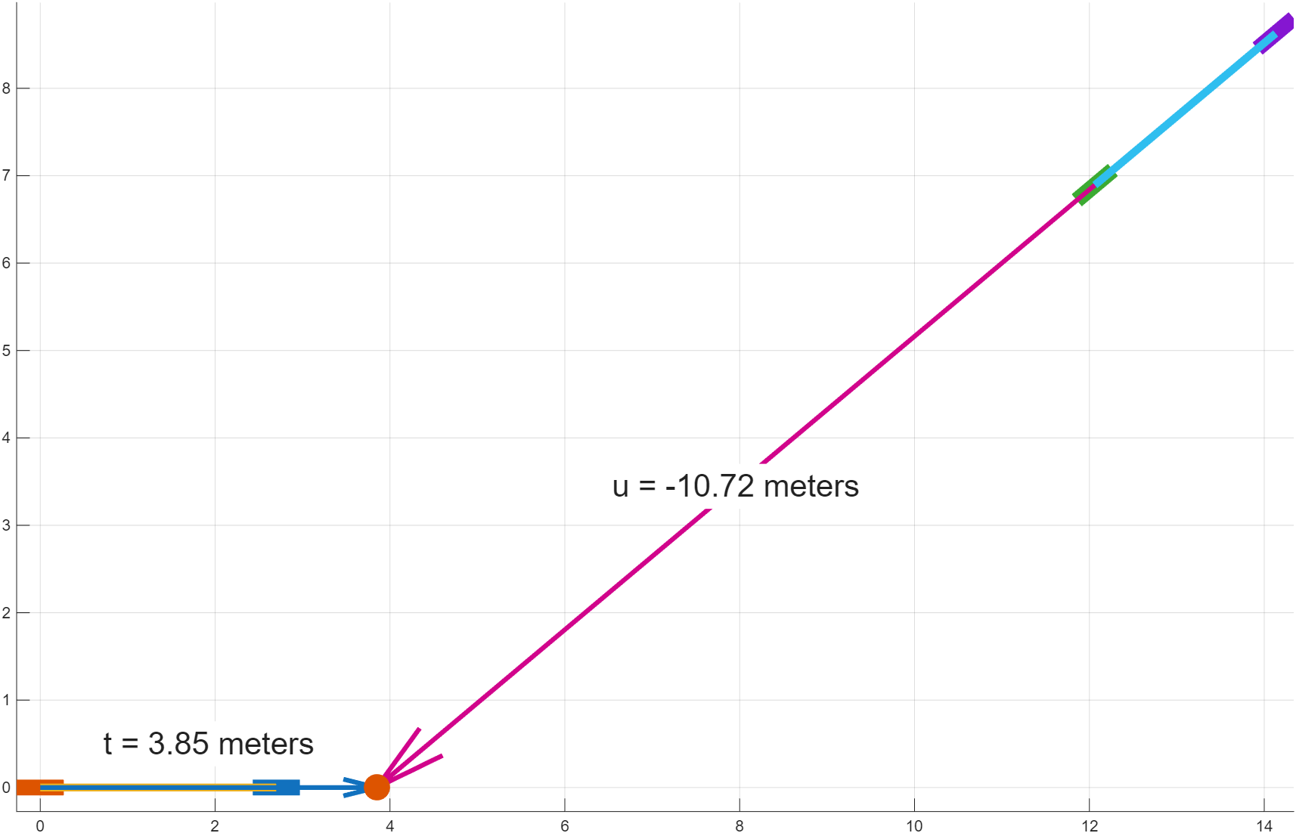
Step 2: Find the x-axis intercept of the given pose
This step finds the t-distance from the initial vehicle’s origin (low-speed, e.g. center of rear tire) to the projection point. It also finds the u-distance from the final vehicle’s origin to the projection point.
%% Step 2: Find the x-axis intercept of the given pose
figNum = 10005;
figure(figNum);clf;
% Define a vector based on the goal point phi angle
goalPhiInRadians = movedGoalPointInXYphi(1,3);
unitGoalVector = [cos(goalPhiInRadians) sin(goalPhiInRadians)];
goalSegment = [movedGoalPointInXYphi(1,1:2); movedGoalPointInXYphi(1,1:2)+unitGoalVector];
xAxisSegment = [0 0; 1 0]; % Unit vector in x-axis direction
% Use Path library to find where this segment intersects the x-axis
% FORMAT:
% [distance, location, path_segment, t, u] = ...
% fcn_Path_findProjectionHitOntoPath(path,...
% sensor_vector_start,sensor_vector_end,...
% (flag_search_type),(figNum))
flagSearchType = 4; % any intersection of the sensor and path lines
[distance, location, ~, tDistance, uDistance] = ...
fcn_Path_findProjectionHitOntoPath(xAxisSegment,goalSegment(1,:),goalSegment(2,:),...
flagSearchType,-1);
% Plot scenario
h_start = fcn_VD_plotStickFigure2DOFBicycleModel(vehicleParameters, movedStartingPointInXYphi', [0; 0], true, (figNum));
set(h_start{1},'DisplayName','Start');
h_end = fcn_VD_plotStickFigure2DOFBicycleModel(vehicleParameters, movedGoalPointInXYphi', [0; 0], true, (figNum));
set(h_end{1},'DisplayName','Goal');
% Plot orientation projection onto X
quiver(movedGoalPointInXYphi(1,1),movedGoalPointInXYphi(1,2),unitGoalVector(1)*uDistance, unitGoalVector(2)*uDistance,0,'LineWidth',3,'ShowArrowHead','on','MaxHeadSize',0.3);
textLocation = [movedGoalPointInXYphi(1,1), movedGoalPointInXYphi(1,2)] + unitGoalVector*uDistance/2;
text(textLocation(1,1), textLocation(1,2),sprintf('u = %.2f meters',uDistance),'FontSize',20,'BackgroundColor',[1 1 1],'HorizontalAlignment','center');
% Plot x-axis distance
quiver(0,0,1*tDistance, 0*tDistance,0,'LineWidth',3,'ShowArrowHead','on','MaxHeadSize',0.3);
textLocation = [0, 0.5] + [1 0]*tDistance/2;
text(textLocation(1,1), textLocation(1,2),sprintf('t = %.2f meters',tDistance),'FontSize',20,'BackgroundColor',[1 1 1],'HorizontalAlignment','center');
% Plot hit
plot(location(1,1), location(1,2),'.','MarkerSize',50);

Slide 15
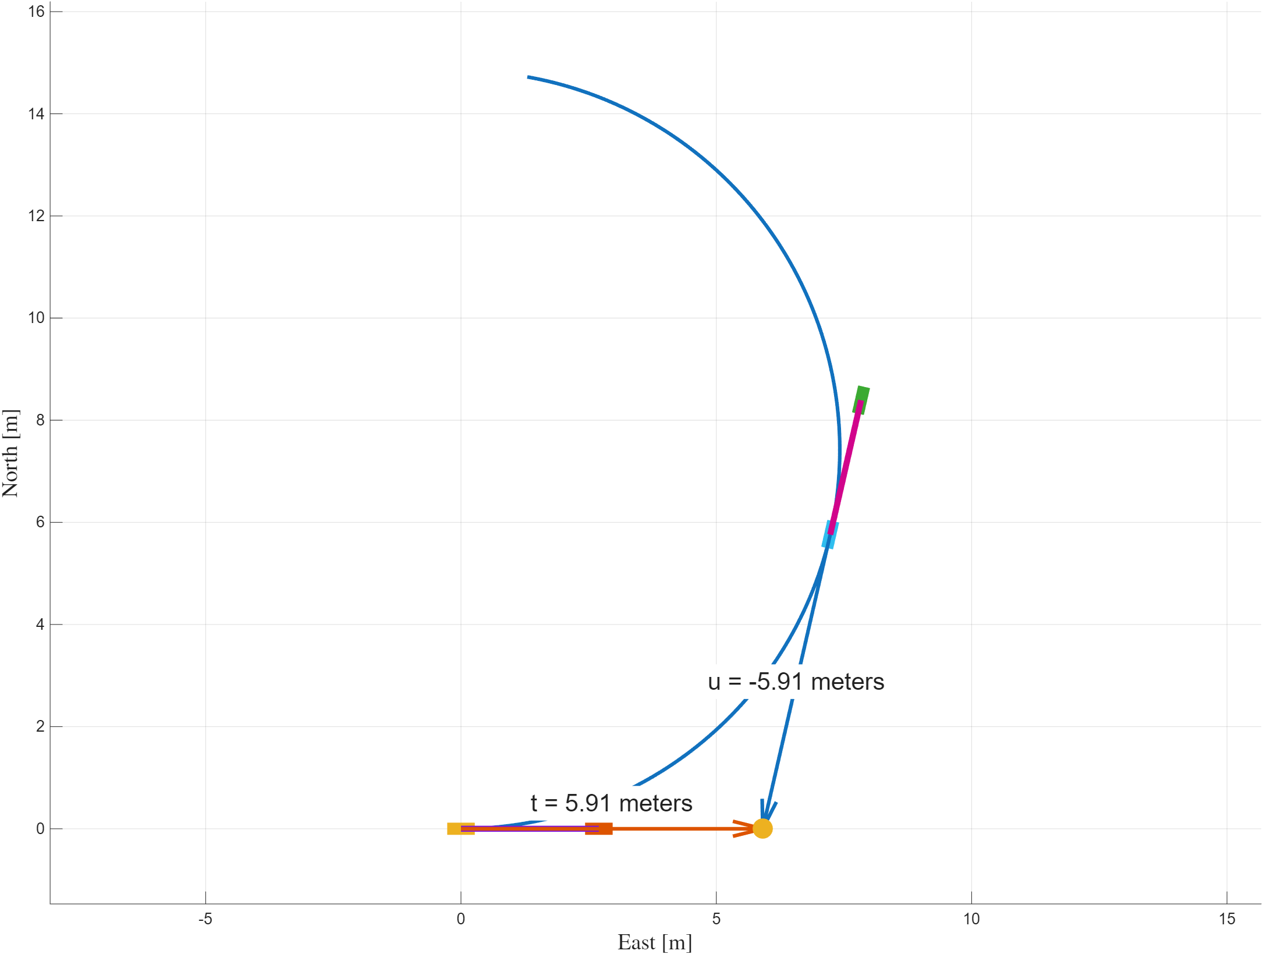
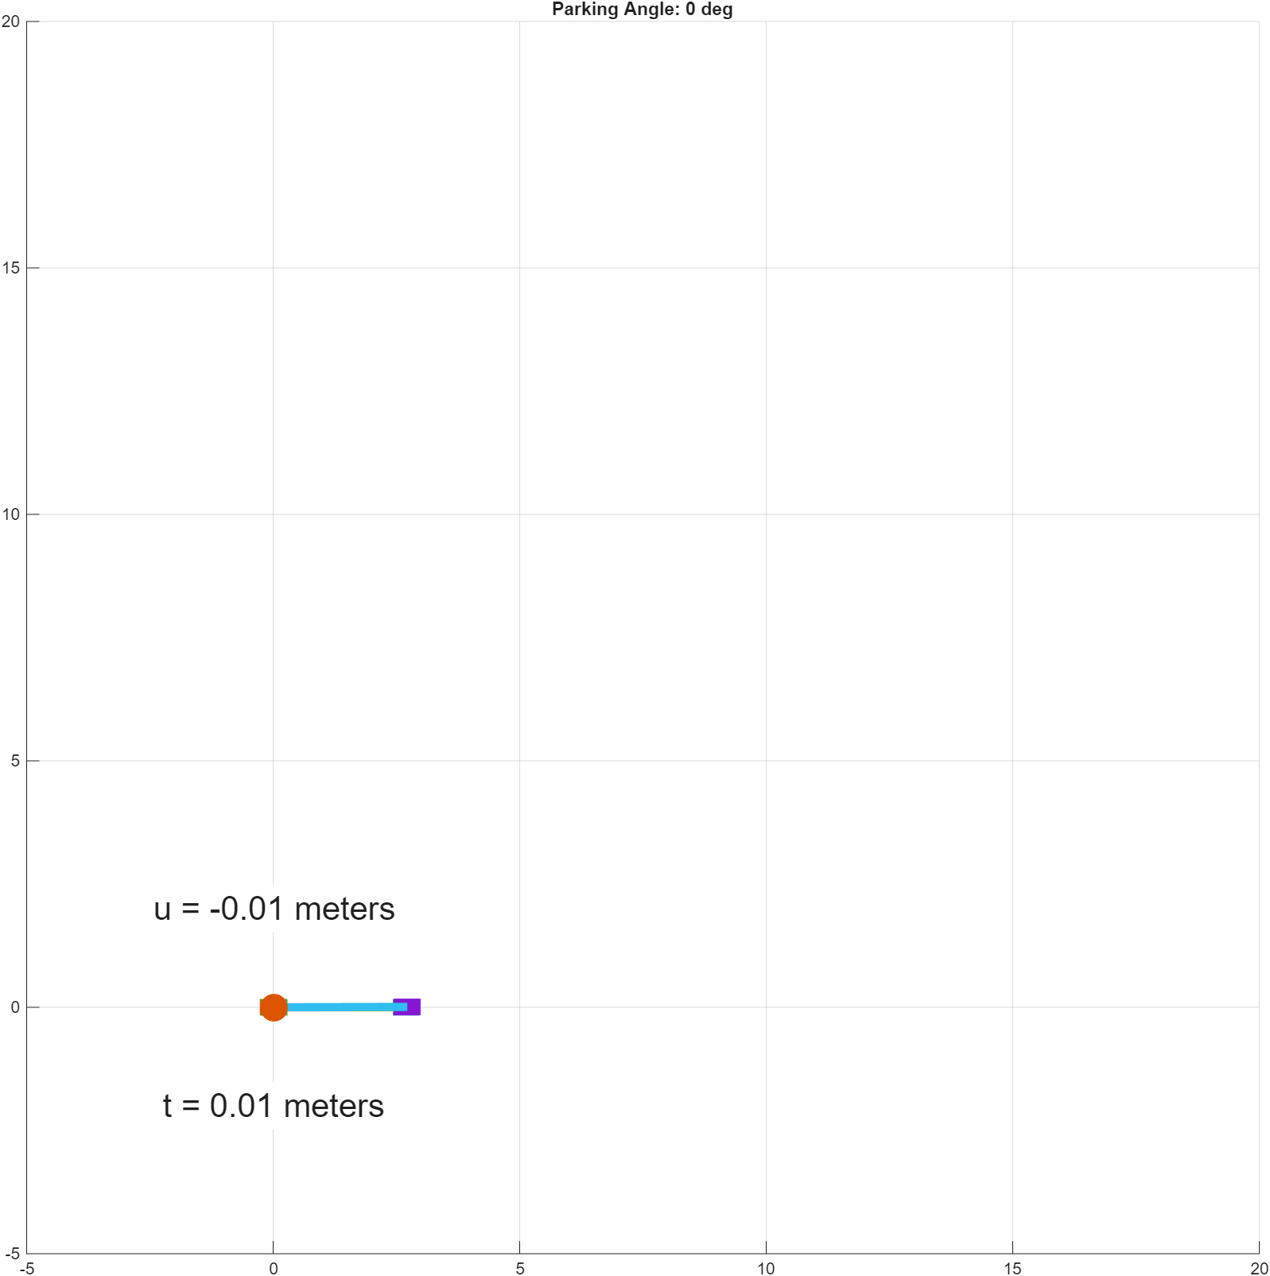
To solve Step 2 quickly, we can generate a plot of the orientation angle versus intercept, so we can use this plot hereafter
We can see that the u and t values are the same, due to symmetry. This is only the case for this particular input (circular).

Slide 16
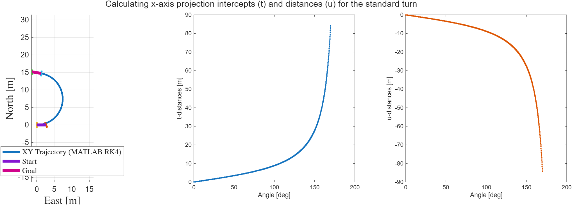
For the constant-steering input, here’s the relationship between parking angle and the values of u and t.

Slide 17
These steps only have to be done once, and this is done in a special function and the data is saved
See: fcn_VD_parkingFillStandardParkingTurnPath
If we change the standard maneuver, we have to re-run this code.

Slide 18
To solve step 3, we simply check that the values are feasible
Of note: we technically can use negative OR positive approach and exit values. Negative values just indicate we need to back up! We don’t allow that here, but it’s easy to do this.
% Look up t-value for this goalPhiInRadians value
minimumTfeasible = interp1(standardParkingTurnPath(:,3),tDistancesEachAngle,abs(changeInArcAngleInRadians),'linear','extrap');
% Look up U-value for this goalPhiInRadians value
maximumUfeasible = interp1(standardParkingTurnPath(:,3),uDistancesEachAngle,abs(changeInArcAngleInRadians),'linear','extrap');
if tDistance<minimumTfeasible
error('t-value is not feasible');
end
if uDistance>maximumUfeasible
error('u-value is not feasible');
end

Slide 19
Finally, to solve Step 4, Calculate the “approach” distance, the “exit” distance, and the arc angle, we compare minimums to calculations
We just subtract the distances for the minimum maneuver from the distances we calculated.
approachPathDistance = tDistance-minimumTfeasible;
exitPathDistance = maximumUfeasible-uDistance;
endOfArcAngleInRadians = changeInArcAngleInRadians;
% Find where the turn starts
unitStartVectorXYPsi = [cos(startingPointInXYphi(1,3)) sin(startingPointInXYphi(1,3)) 0];
turnStartXYPsi = startingPointInXYphi + unitStartVectorXYPsi*approachPathDistance;
[approachXYPsi, curveXYPsi, exitXYPsi] = fcn_VD_parkingPlotSolution(...
standardParkingTurnPath, turnStartXYPsi, ...
approachPathDistance, endOfArcAngleInRadians, exitPathDistance, ...
([]), (-1));

Slide 20
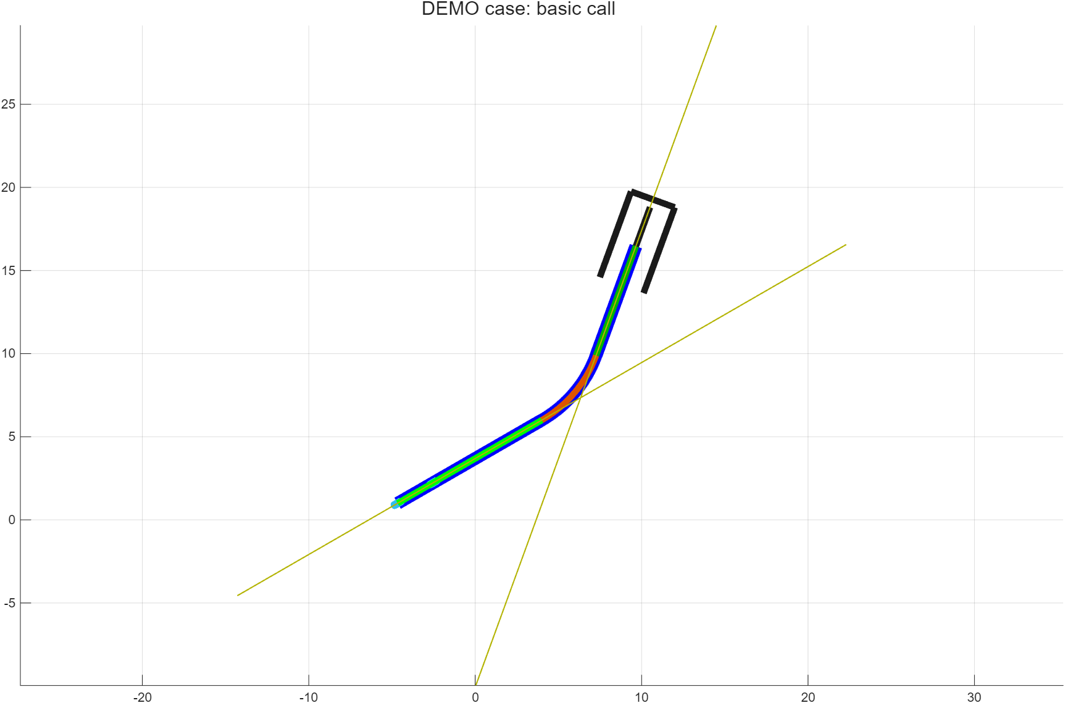
These steps are coded within a function: fcn_VD_parkingCalcEntryArcExitPaths
We need to know:
The details of the standard maneuver
  standardParkingTurnPath,
  tDistancesEachAngle,
  uDistancesEachAngle
Our starting position in XYyaw
Our parking “goal” position in Xyyaw
See script_test_fcn_VD_parkingCalcEntryArcExitPaths
for examples

